Slide 1

Md Hasan

Slide 2
Topics
Class and Object
Constructor and types
Destructor
Oops and advantages
Inheritance
Polymorphism
Encapsulation
Abstraction
Abstract class vs interface
Abstract class vs Encapsulation

Slide 3
Class
Class is a user defined data type that contains data members (like field, properties) and member function (like methods, constructor, destructor).
It’s like template for an object or blueprint.
Syntax:-
Class classname
{
Variable declaration;
Method declaration;
}

Slide 4
Object
An object is a real world entity having attributes(fields) and behaviors(method)
For example, a student object can have attributes name, address and contact number. A student can perform activities like attending class, giving exam etc.
Syntax:
Classname objectname = new classname()

Slide 5
Example of Class and object
using System;
public class Student
{
int id;//data member (also instance variable)
String name;//data member(also instance variable)
public static void Main(string[] args)
{
Student s1 = new Student();//creating an object of Student
s1.id = 101;
s1.name = "Sonoo Jaiswal";
Console.WriteLine(s1.id);
Console.WriteLine(s1.name);
}
} // output: 101 and Sonoo Jaiswal

Slide 6
Constructor
A special type of function/method which has same name as its class
Call automatically whenever an object of a class is created
Responsible for object initialization and memory allocation of its class members
Doesn’t have a return type, not even a void type.
Syntax:-
class Car {
// constructor
Car() {
//code
}
}
Car car1 = new Car();

Slide 7
Constructor Types
Default Constructor:- A default constructor is a constructor with no parameters.
Parameterized Constructor:- A parameterized constructor is a constructor with one or more parameters.
Copy Constructor:- A copy constructor is a constructor that takes an object of the same class as a parameter and initializes a new object with the same values.
It is used to create a new object that is a copy of an existing object.

Slide 8
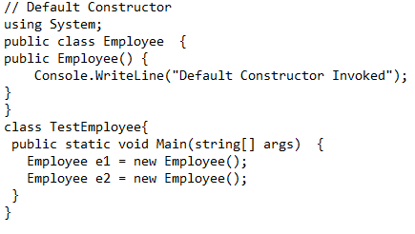
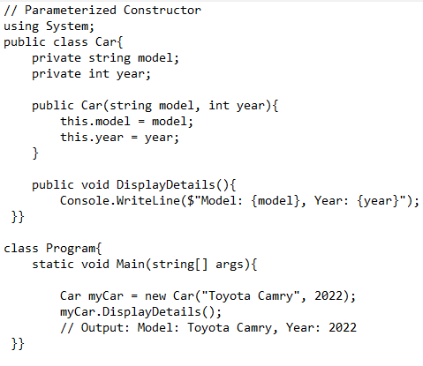
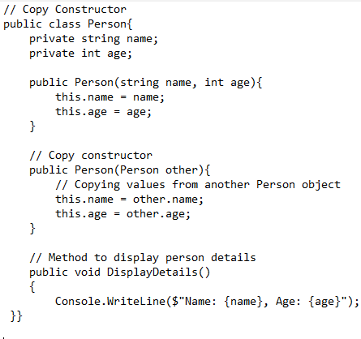
Constructor types example

Slide 9
Destructor. tilde(~)
A destructor is a special method in C#.
It is automatically called when an object is about to be removed from memory.
Destructors are used to release any unmanaged resources held by the object.
They ensure that resources like file handles or database connections are properly released before the object is deleted.

Slide 10
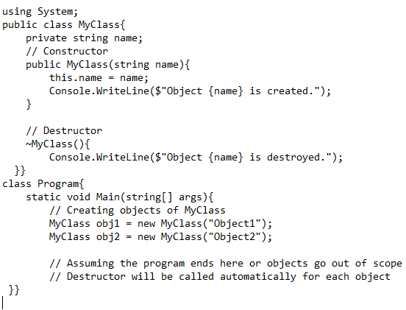
Destructor example

Slide 11
What is oops and Advantages of oops
The type of programming which is based on objects rather than functions and procedures programs are divided into small objects for better understanding and for better maintainability.
Advantages:-
Helps users to understand software easily
With oops, the code is more readable, understandable and maintainable.
Reusability of code can be done easily.
It allows data hiding hence providing security

Slide 12
Basic concept of oops
There are main four core principles of any object oriented language.
Inheritance
Polymorphism
Encapsulation
Data Abstraction

Slide 13
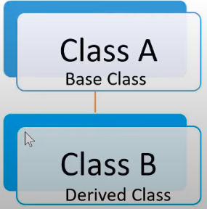
Inheritance
A mechanism of acquiring the features and behaviors of a class by another class.
He class whose members are inherited is called base class, and the class that inherits those members is called derived class.

Slide 14
Types of Inheritance
Single level Inheritance
Multi-level Inheritance
Hierarchical Inheritance
Hybrid Inheritance (Not supported by c#)
Multiple Inheritance(Not supported by c#)

Slide 15
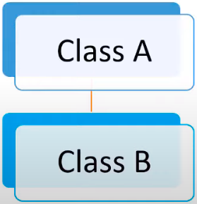
Single Level Inheritance
In this inheritance, a derived class is created from a single base class.
using System;
public class Animal {
public void eat() { Console.WriteLine("Eating..."); }
}
public class Dog: Animal {
public void bark() { Console.WriteLine("Barking..."); }
}
class TestInheritance2{
public static void Main(string[] args) {
Dog d1 = new Dog();
d1.eat();
d1.bark();
}
}

Slide 16
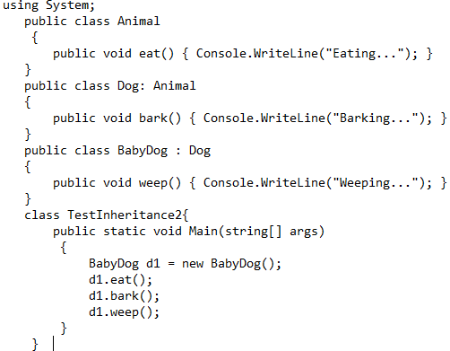
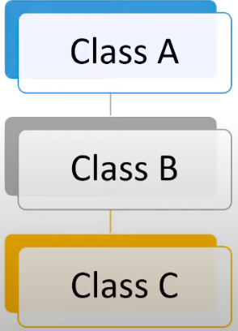
Multi-Level Inheritance
In this inheritance, a derived class is created from another derived class.

Slide 17
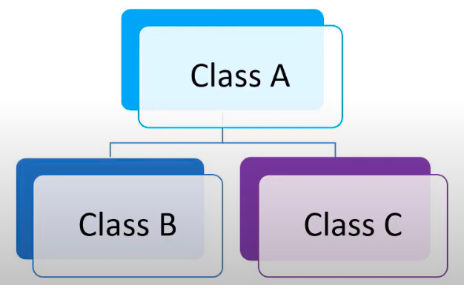
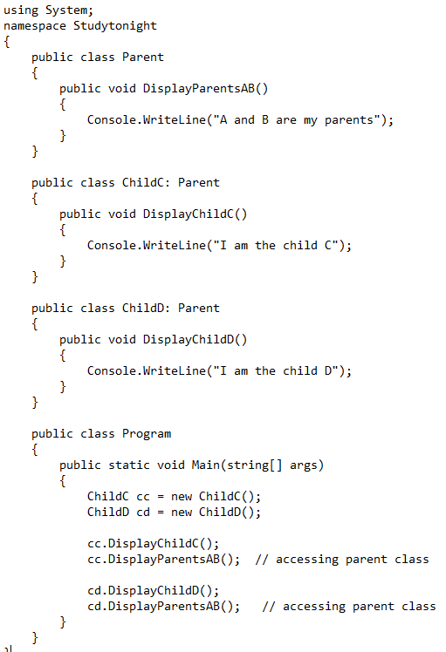
Hierarchical Inheritance
In this inheritance, more than one derived classes are created from a single base.

Slide 18
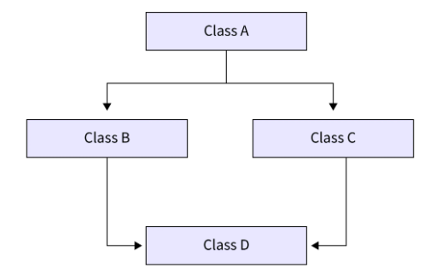
Hybrid Inheritance
This is combination of more than one inheritance.
Since C# doesn’t support multiple inheritance with classes, the hybrid inheritance is also not possible with classes.
In C#, we can achieve hybrid inheritance only through Interfaces.

Slide 19
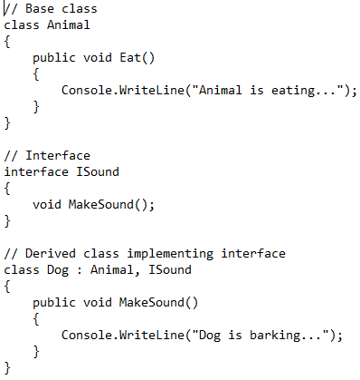
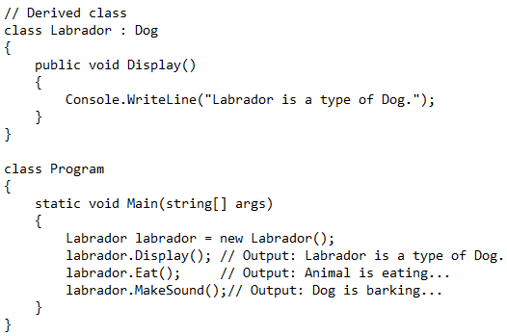
Hybrid Inheritance example

Slide 20
Multiple Inheritance
Multiple inheritance is a feature in object-oriented programming where a class can inherit properties and behaviors from more than one parent class. While C# does not support multiple inheritance with classes, it does allow it with interfaces.
Multiple inheritance allows a class to inherit attributes and methods from more than one parent class.

Slide 21
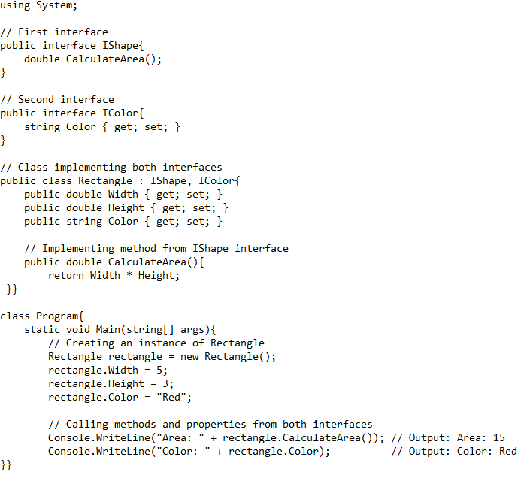
Example of multiple inheritance

Slide 22
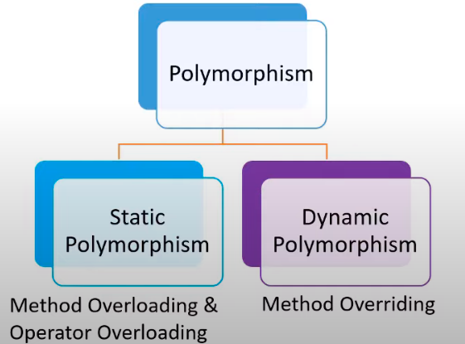
Polymorphism
Ability of an object to behave in multiple ways
For examples, smart phone is a single object but it can be used for making calls, listening music, sending emails, taking pictures etc.

Slide 23
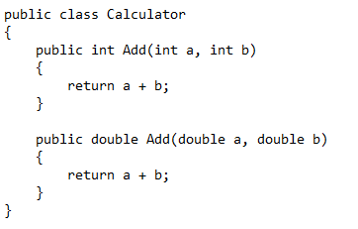
Compile-Time Polymorphism (Method Overloading):
Method overloading allows multiple methods with the same name but different parameters or return types to coexist within the same class.
The compiler determines which method to call based on the number, type, and order of parameters during compile-time.
Example:-

Slide 24
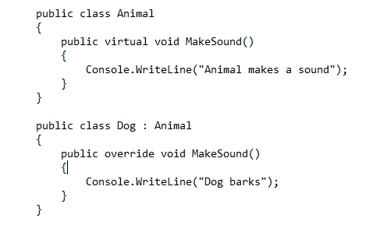
Runtime Polymorphism (Method Overriding):
In method overriding, a derived class have the same methods with exactly the same signature as base class.
when overriding a method in a derived class, the method signature, including the method name and parameters, must match exactly with the method being overridden in the base class

Slide 25
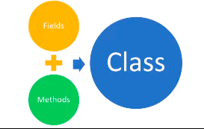
Encapsulation
A mechanism of binding the object state(fields) and behavior(methods) together into a single unit.
The encapsulation mainly achieved by creating classes.
The class is kind of container or capsule, which encapsulate the set of fields and methods.
In C#, encapsulation is achieved through the use of classes and access modifiers.

Slide 26
Access Modifiers
Used to specify the accessibility of a member(field, method) or type (class, interface)
Access modifiers like private, protected, internal and public control the visibility and accessibility of class members (attributes and methods).
private: Members are accessible only within the same class.
protected: Members are accessible within the same class and its derived classes.
internal: Members are accessible within the same assembly (or project).
public: Members are accessible from any other class.

Slide 27
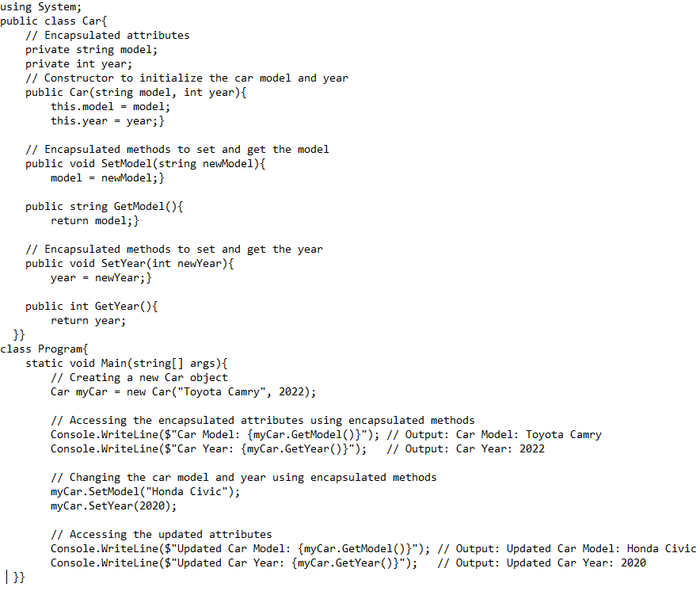
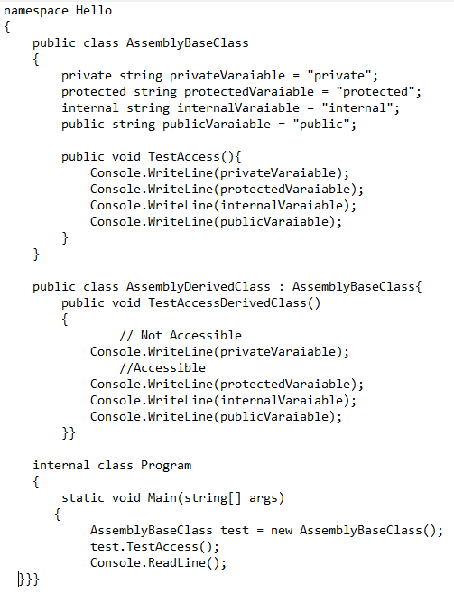
Examples
.

Slide 28
Abstraction
A mechanism to provide the details about essential features without describing the background details.
For example, when you login into a website, you enter your userId and password which is the essential information for login.
Here you don’t know about the background details like what happens with our userId and password, how it gets verified. All is abstract from you.
Abstraction can be achieved by two ways:-
Abstract class
Interface

Slide 29
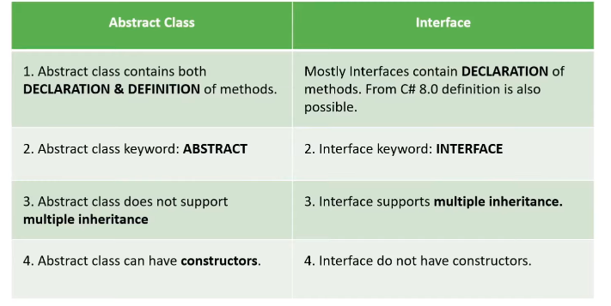
Abstract class vs Interface

Slide 30
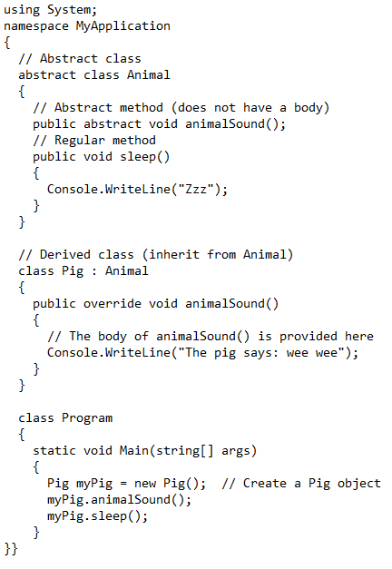
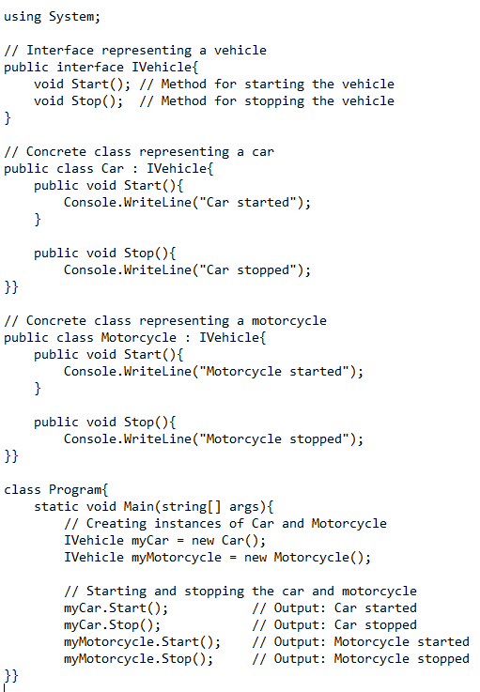
Abstract class and Interface example

Slide 31
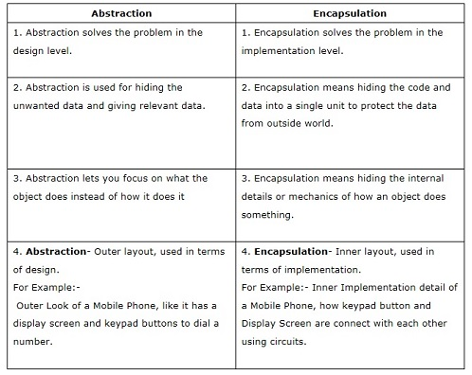
Abstraction vs Encapsulation

